Slide 1


Microcontroller Based Energy Controller for Grid Integrated DC Source in a PV System
Faculty Of Engineering
University Of Ruhuna
SANJEEWANI T.G.P RU/E/2011/158
WIJERATHNA W.M.S.M.M RU/E/2011/184
DHARMASENA G.T.S RU/E/2011/190
SUPERVISED BY: MRS. IRESHIKA M.A.S.T

Slide 2
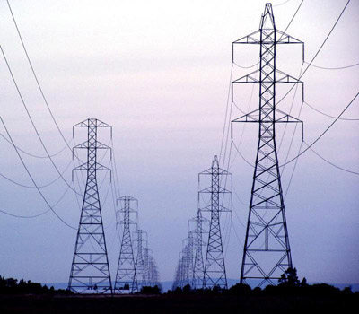
Outline
Introduction
Problem statement
Implemented design
Conclusions

Slide 3

Introduction
Our Goal
To produce a microcontroller based energy controller for VSI synchronized with a low voltage grid.
To control the frequency, voltage and energy of the designed system.

Slide 4

Problem Statement
Uncontrolled behaviour of PV systems
High cost of the existing inverter technologies
Stability issues and low quality of output power
Islanding effect
Unfavorable conditions
To Incorporate with present technologies such as net metering
Notes:
Unfavorable conditions are total harmonic distortion, voltage dips, voltage fluctuations, voltage surges etc.
Normal condition, Harmonic condition and Non-harmonic condition

Slide 5

Design Architecture
DC Source
P, Q Control Unit
DC
Microcontroller based Energy Control Unit
DC
Boost Converter
DC
AC
Voltage Source Inverter (VSI)
PC based GUI Interface
Synchronization Unit
Manual and Automatic Mode
Visualize the variation of P and Q
Grid

Slide 6

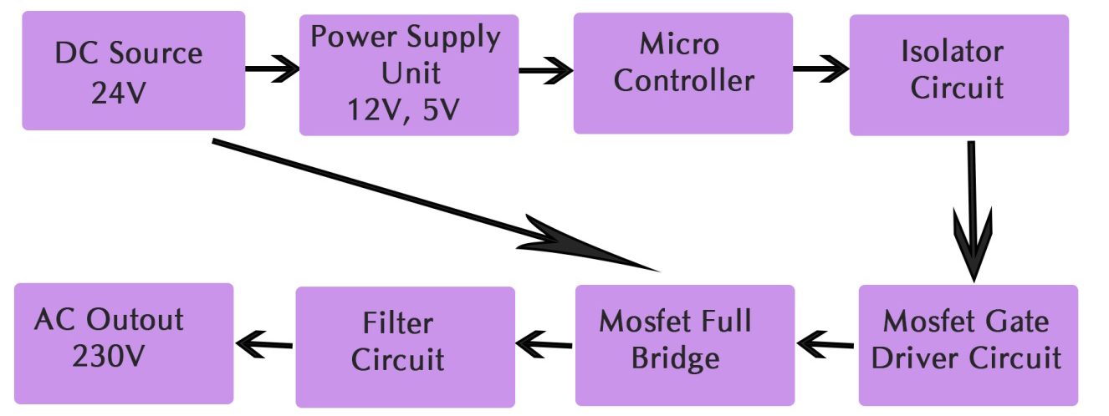
Inverter Design

Slide 7
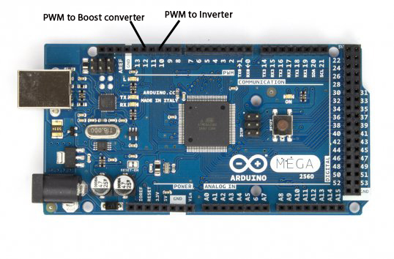
Microcontroller

Slide 8
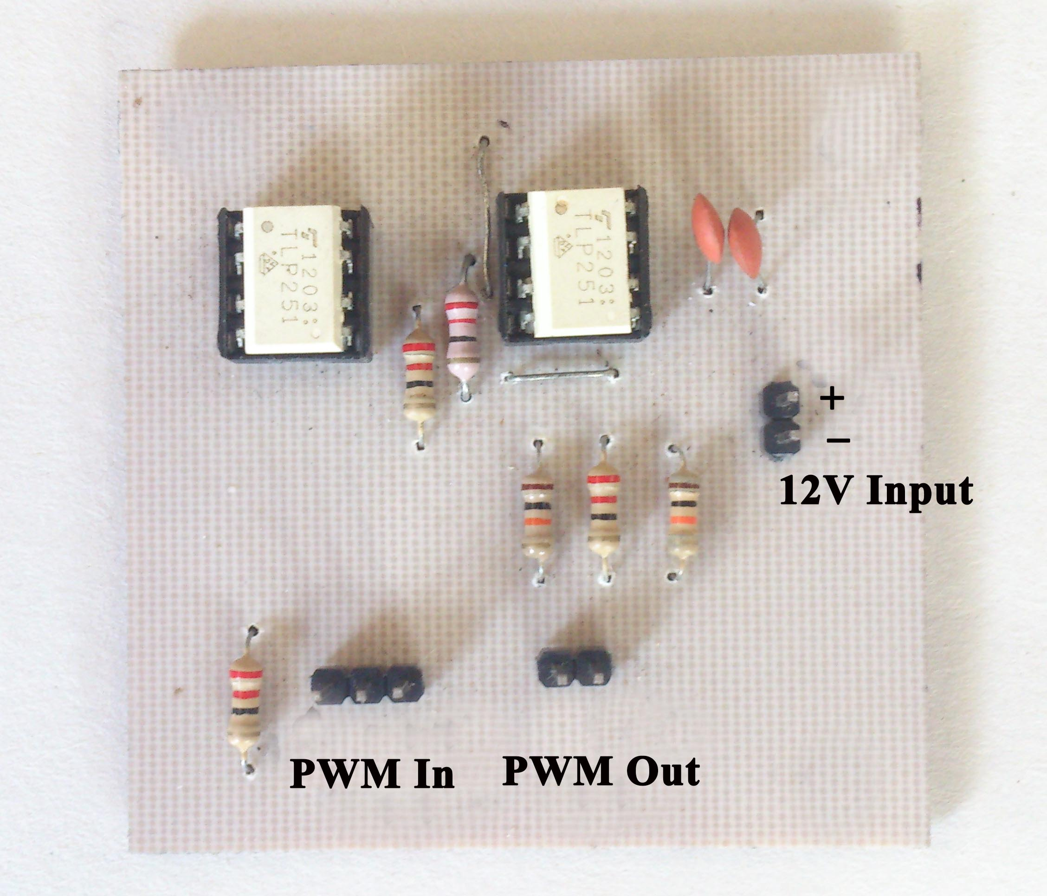
Optocoupler Circuit

Slide 9
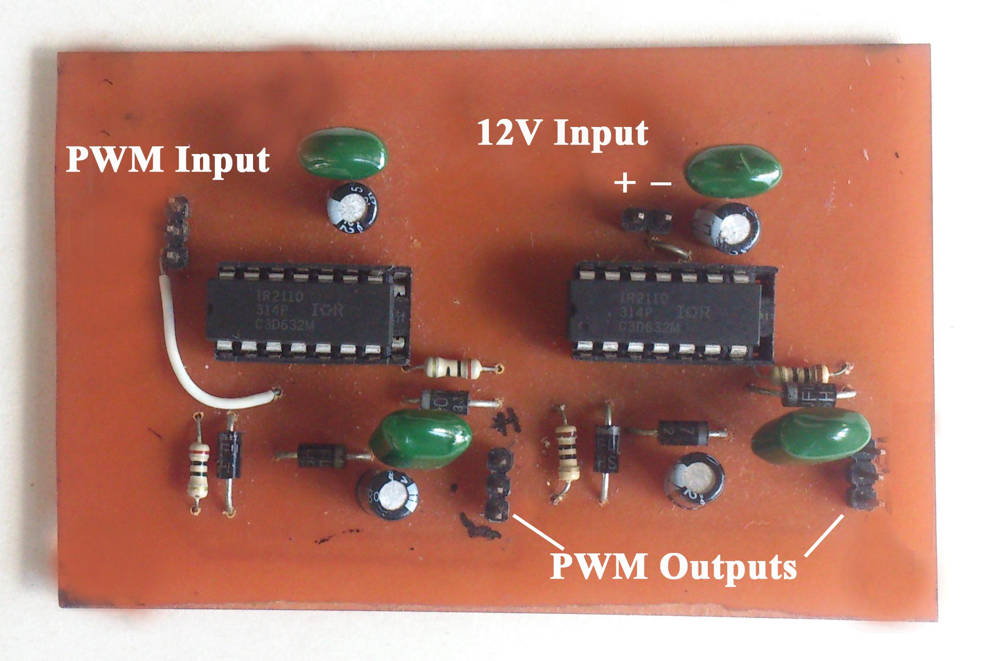
Gate Driver Circuit

Slide 10
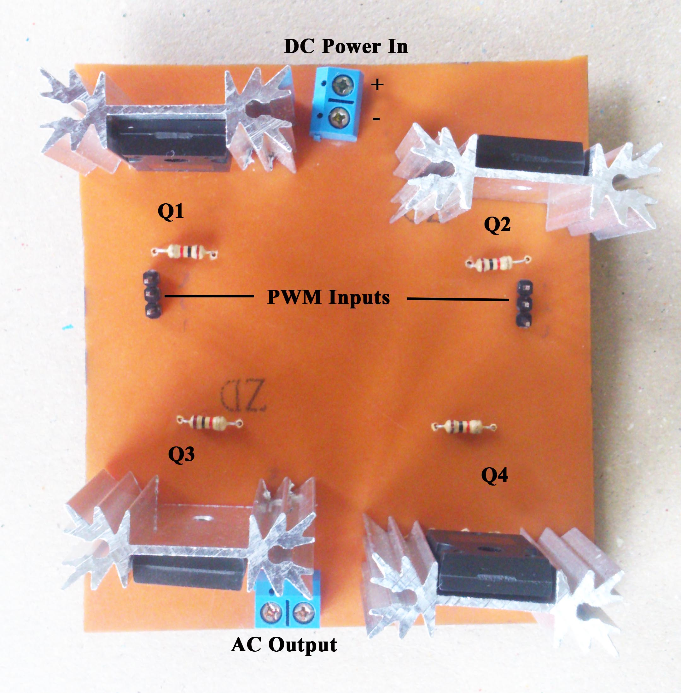
Mosfet Full Bridge
Single Phase MOSFET Full Bridge

Slide 11
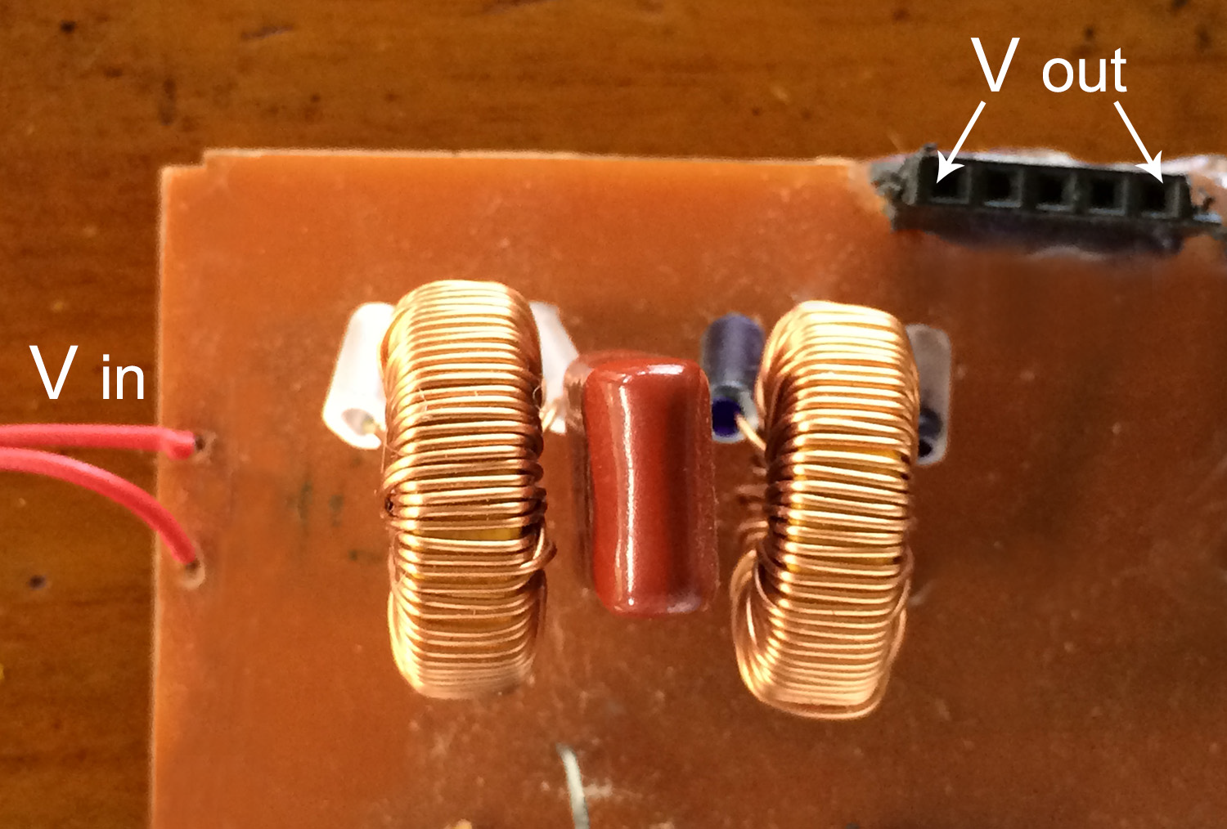
Filter Circuit
Low Pass LCL Filter

Slide 12
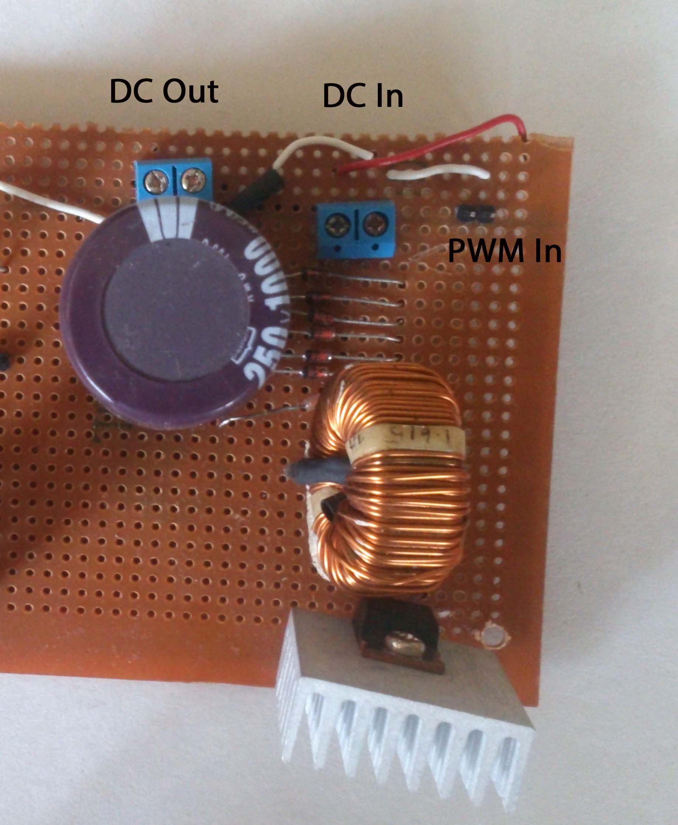
DC to DC Converter Design
Boost Converter

Slide 13
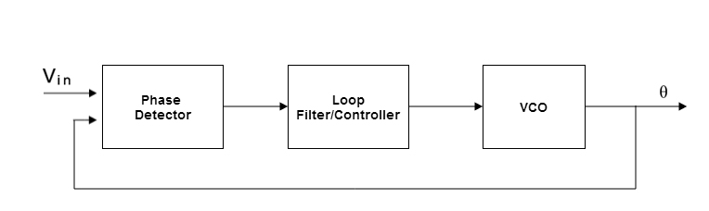
Synchronization using PLL Technique
Phase Detector Based Phase Locked Loop Technique

Slide 14
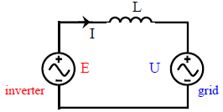
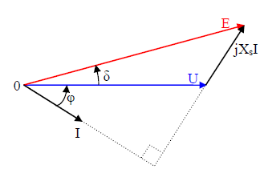



Active and Reactive Power controlling
Voltage controlling Method of Power controlling

Slide 15
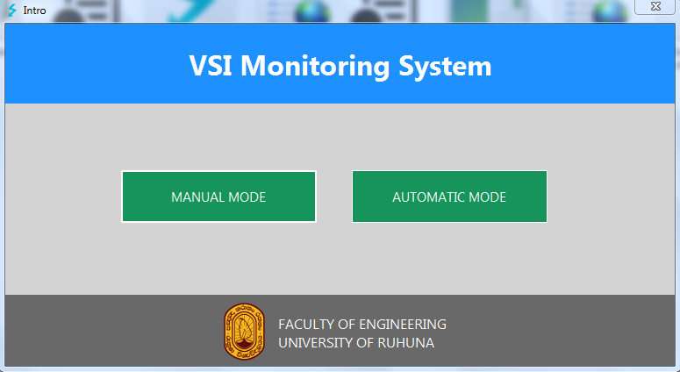
Graphical User Interface

Slide 16
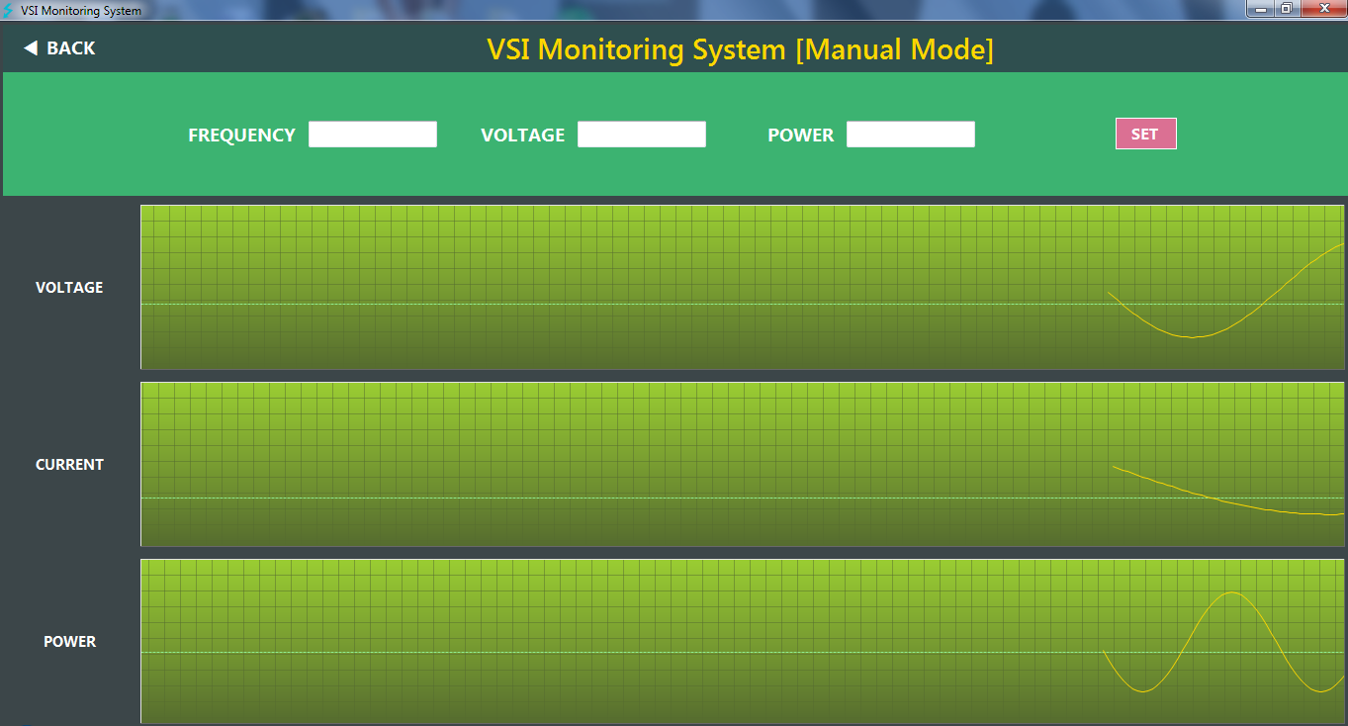
Manual Mode

Slide 17
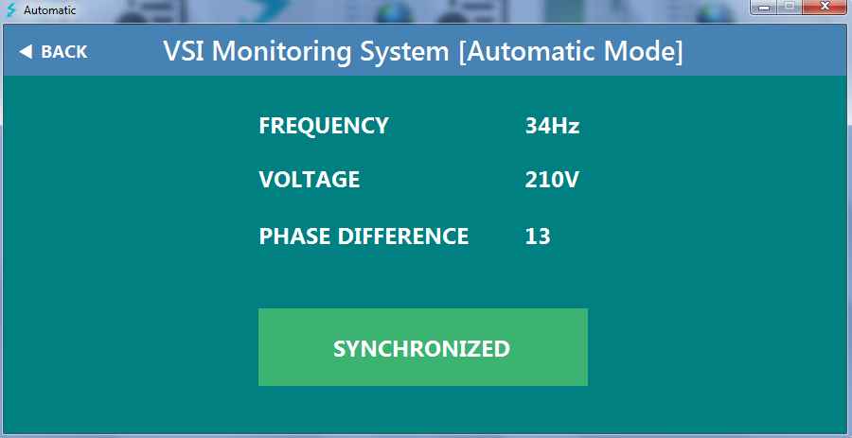
Automatic Mode

Slide 18
Conclusions
PD based PLL method of synchronization
&
Voltage controlling method of power controlling
can be identified as most suitable methods of synchronization and power controlling respectively that can be used when integrating VSIs with low voltage grid.

Slide 19
Thank You..!

Slide 20
Supplementary Slides

